Slide 1
Metrics that Matter
EIT Digital Master School @Eötvös Lorand University
Business Development Lab
Inspired by Danny Crichton “The Complete Quantitative Guide To Judging Your Startup”

Slide 2
Engines of Growth Metrics
 | STICKY | VIRAL | PAID
Approach | Keep people coming back | Make people invite friends | Spend money to get customers
Metrics | New Customer Acquisition - Churn Rate (make them faster that you loose them) | Viral coefficient (How many they tell, how fast they tell them) | Cost per Acquisition Customer Lifetime Value
Example | Database Solutions | Hotmail, Facebook | IMVU

Slide 3

Factors that influence VCs
5 groups of metrics:
financial, user, acquisition,
sales, and marketing
their weight will depend on the type of startup,
And on VC’s opinion

Slide 4

Financial Metrics
Some companies are funded simply for having a great balance sheet and cash flows.

Slide 5
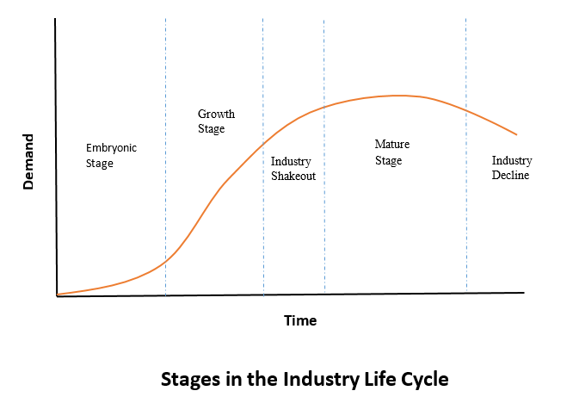
Financial Metrics: Monthly Revenue Growth
Take the current month’s revenue, subtract last month’s revenue, and then divide by last month’s revenue.
(RevNow – RevBefore)/ RevBefore
In general 40 % per month is very good.

Slide 6
Financial Metrics: Monthly Revenue Growth
it shows proportion without magnitude!
If $20 last month, you need +$30 to get a 50% growth rate.
That might be a single customer.
But if you have a $10 million per month revenue?
Reaching the same growth is significantly more challenging.

Slide 7
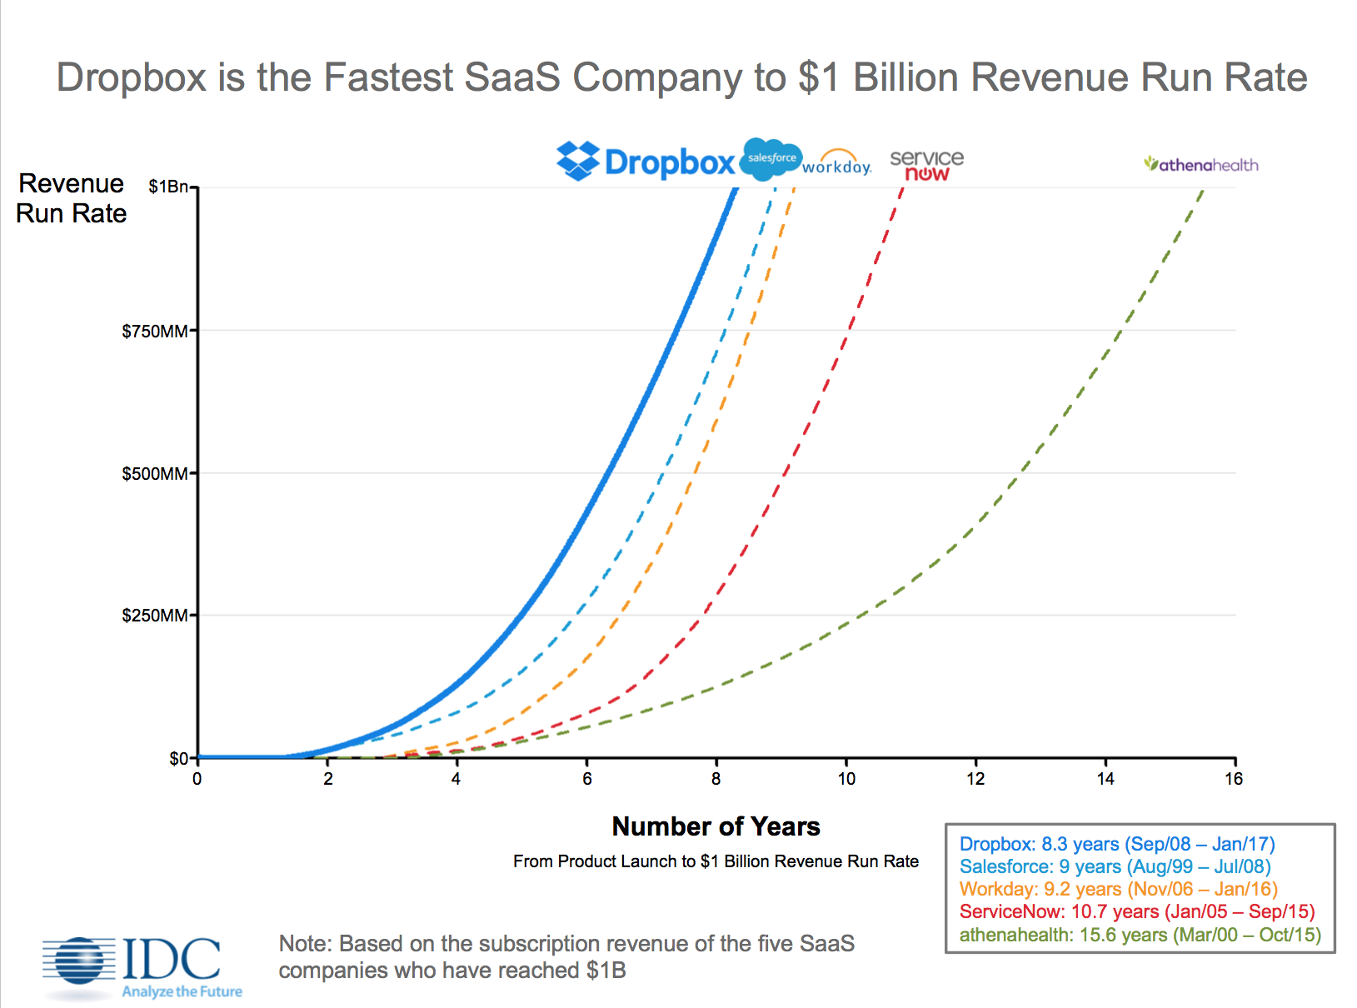
Financial Metrics: Revenue Run Rate
Take the revenues recognized in the most recent month and multiply by 12.
(projected run rate in 12 months)

Slide 8
Financial Metrics: Revenue Run Rate
preferred since it consider magnitude!
VCs think about where the business has to be in 18–24 months
when the next fundraise will happen
whether series B or C growth investors are likely to be interested

Slide 9
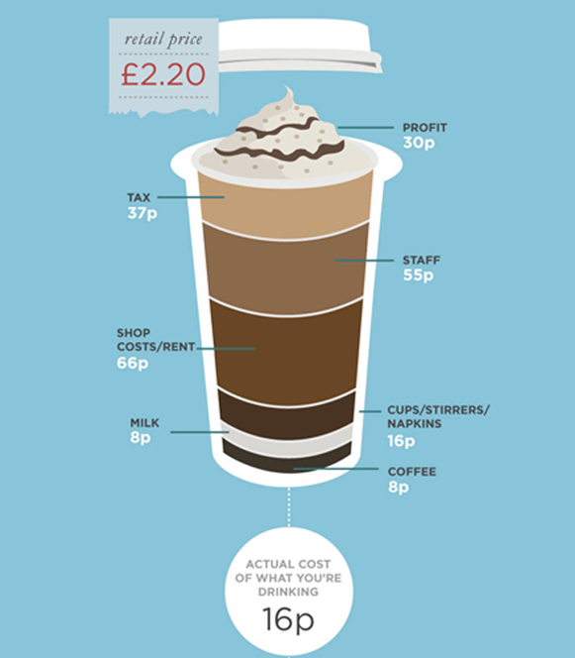
Financial Metrics: Margins
Gross margin:
total revenue minus the “cost of goods sold” divided by the revenue.
Net margin:
subtract the total expenses of the business as well (except for taxes and a handful of other accounting line items).

Slide 10
Financial Metrics: Margins
Show the ability of your startup to spend venture capital and get significant return.
Margins guidelines should be given according to the industry:
ex. cloud storage and services ~90%
SAAS and SW businesses ~ 70%
HW max 40%

Slide 11
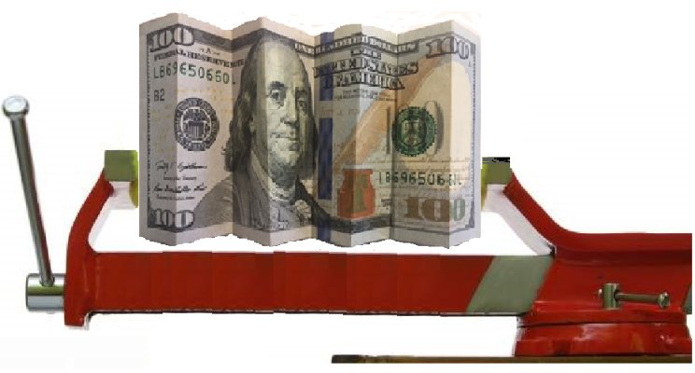
Financial Metrics: Margins
Beware of margin compression:
Margins become tighter when competition is greater
Must develop defenses against new entrants

Slide 12

Financial Metrics: Burn Rate and Runway
Burn Rate:
This is the operating loss per month.
Runway:
Take the amount of available capital and divide by the monthly burn rate to get the number of months until your start-up runs out of cash.

Slide 13
Financial Metrics: Burn Rate and Runway
These numbers show:
efficiency of a business,
the timeline for fundraising,
and the need for capital.
VCs expect their entire investment to be spent within 18–30 months.
=> you must develop a very clear plan on how the burn rate is going to increase, and how that will propel the growth of the business.

Slide 14

User Metrics
Users are the lifeblood of any company

Slide 15
User Metrics: K-Value
Choose a time frame, take the number of users at the beginning of the as a base.
Now, track all invites that these users make to other people (for example, using an “Invite Your Friends” link).
Aggregate the number of new users entering through this channel and then calculate the ratio of new users to old users and add 1.

Slide 16
User Metrics: K-Value
if you start with 1,000 users,
they bring 200 new users,
ratio of .2 + 1 (our base population) => k-value = 1.2.
is a measure of virality: This number is exponential, and defines the magnitude of the user growth rate by word of mouth
1 means that the population is stable.
1.2 is strong, and > 1.4 incredible growth.

Slide 17

User Metrics: Proportion of Mobile Traffic
Take the number of visits from mobile and divide by the total number of visits to your product.
People spend a majority of their computer usage on mobile devices.
Engaging such users is crucial today.

Slide 18

User Metrics: Churn
Take the number of users who leave and divide by the number of total users (regardless of start time).
For paid products like SaaS, churn tend to make more impact.
SaaS churn in (1–3 percent) is strong.

Slide 19
User Metrics: Cohort Analysis
Take all of the users who joined a product in a given time frame (usually a week). Then calculate how many of these users engaged with the product over every successive week.
a metric by which we see the decay in user engagement.
First-week retention and Seasonality can be an important.
For social media: 80% one-week churn is very high,
40% is good, 20 % awesome.

Slide 20
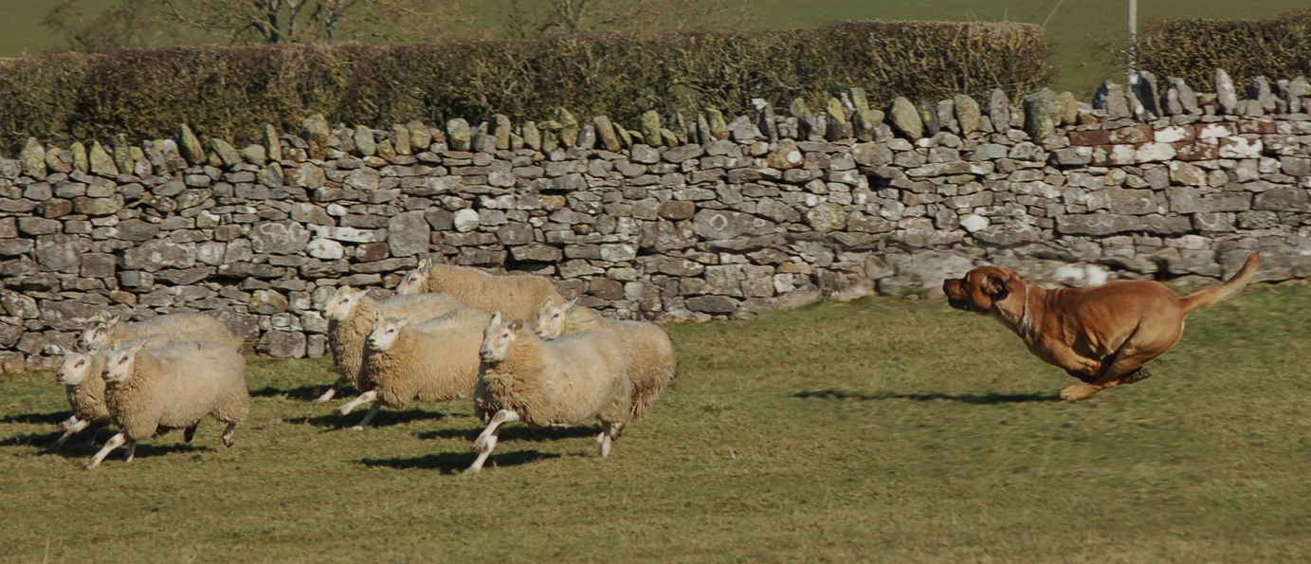
User Acquisition
Metrics
These metrics go to the core of a business model and its sustainability

Slide 21
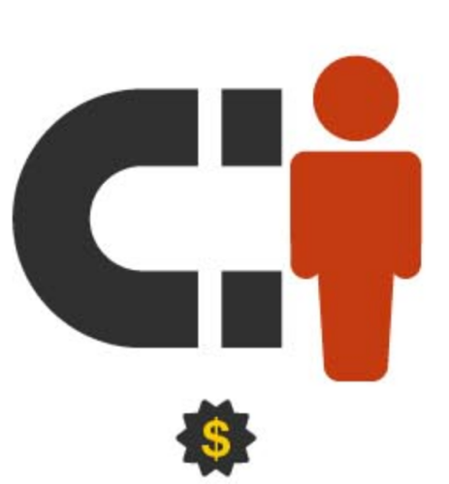
UA Metrics : Cost of Acquiring a Customer
Take the amount spent on all forms of user acquisition (search engine marketing, content marketing, public relations, etc.) and divide by the number of new users within a given period.
Often split this into paid and free channels
Express the number of free versus paid acquisitions as a ratio

Slide 22
UA Metrics : Cost of Acquiring a Customer
The higher the ARPU – average revenue per user – the higher the cost of acquiring a customer can be.
social media: needs to be as low as possible
(0 if growth is purely viral)
e-commerce: great CAC around $30–$60 per user.
above $200 are pretty rare in online businesses
(ex. financial services)

Slide 23

UA Metrics : Payback
Payback time for a new user.
In e-commerce: # of orders that need to be purchased to cover the cost of acquiring a customer.
For advertising driven and freemium subscription startups:
3–6 months are good

Slide 24
UA Metrics: Net Promoter Score
Run a survey among customers asking how likely they will recommend your product on a 1 to 10 scale.
- Promoters= 9 or 10,
- Detractors= 1 or 2.
Calculate the proportion on the total of the survey population.
The net promoter score = % of promoters - % of detractors.

Slide 25
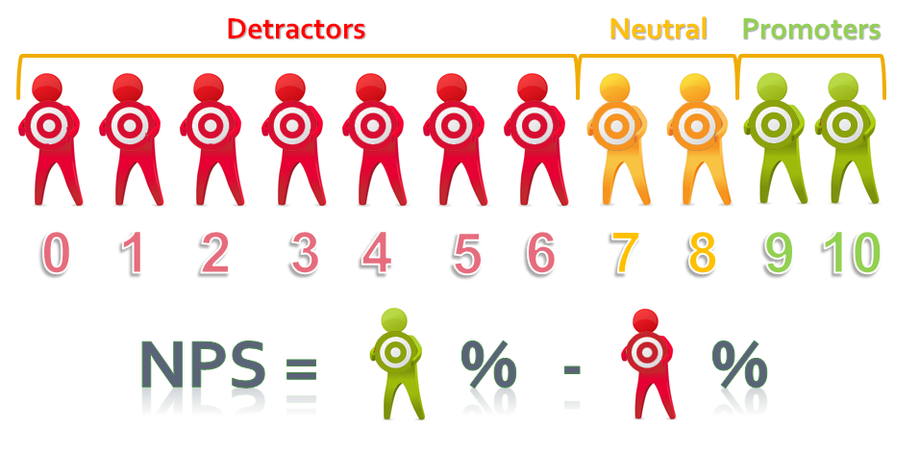
UA Metrics: Net Promoter Score

Slide 26

UA Metrics: Net Promoter Score
ex. 50%promoters - 10% detractors => NPS 40.
It shows how satisfied your customers are
NPSs of 50 are considered excellent
(like Amazon and Google)

Slide 27

Sales Metrics
You have to build sales channels to build revenue.

Slide 28

Sales Metrics: Magic Number
Take the net growth of subscription revenue over two quarters, multiply by 4, and then divide by the total spend on sales and marketing.
(Q1 - Q2) *4 / expenses = MAGIC NUMBER
($400,000 - $200,000) *4 /$300,000 = 2.66.
ROI: for each dollar we spend
we get the magic number back in revenue

Slide 29
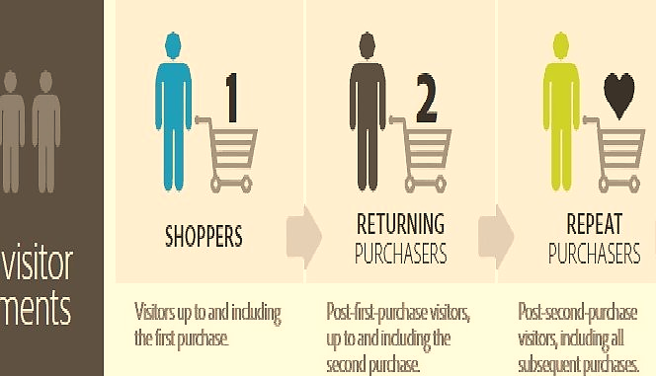
Sales Metrics: Basket Size and Order Velocity
The average sales price (ASP)
is the price of a typical order.
Order velocity
is the time it takes for a customer to make a repeat purchase.

Slide 30


Sales Metrics: Basket Size and Order Velocity
High ASP means:
wealthier customers,
fewer repeat purchases,
more flexibility on the cost of acquiring a customer
Order velocity also is influenced by ASP:
The lower the ASP,
the higher the velocity of sales needs to be

Slide 31

Market Metrics
Understanding the size of a market
and its composition

Slide 32


Market Metrics: Total Addressable Market
The total amount of money spent in a startup’s defined space.
Its an opportunity for a founder to demonstrate an understanding of their startup’s market.
markets >$1 billion are good
uses the word “trillion” and
get a laugh from any VC!

Slide 33

Market Metrics: Average Wallet Size
Average wallet size is the total amount that a single customer can spend in a given period of time for a category of services (i.e. its budget).
A key metric particularly enterprise companies
Allows a VC to judge how expensive your product is relative to a customer’s appetite

Slide 34
Metrics that Matters
One very good metric matter more than a complete set of decent ones
Ex. an incredible k-value by a social media company
Outstanding metrics are necessary to successfully fundraise
Great companies are built from greatness,
both quantitative and qualitative

Slide 35
Thank you!
Brought to you by EIT Digital Master School @Eötvös Lorand University
Find me at: anna.reale@inf.elte.hu

